Slide 1
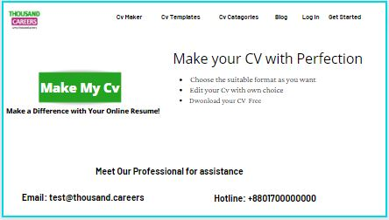
The Landing page( samples)

Slide 2
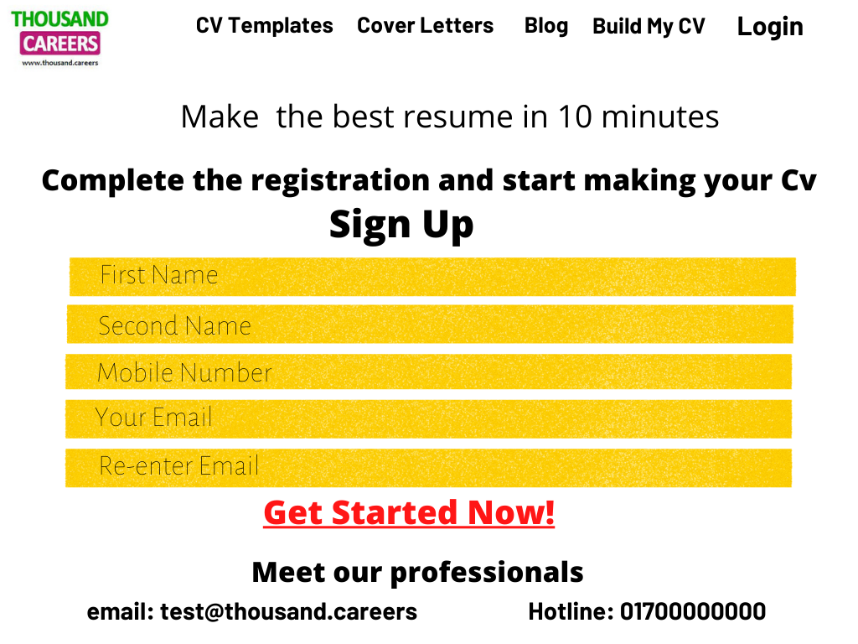
After Clicking the “Make MY CV” button, the users will get the following table of registration ( sample)

Slide 3
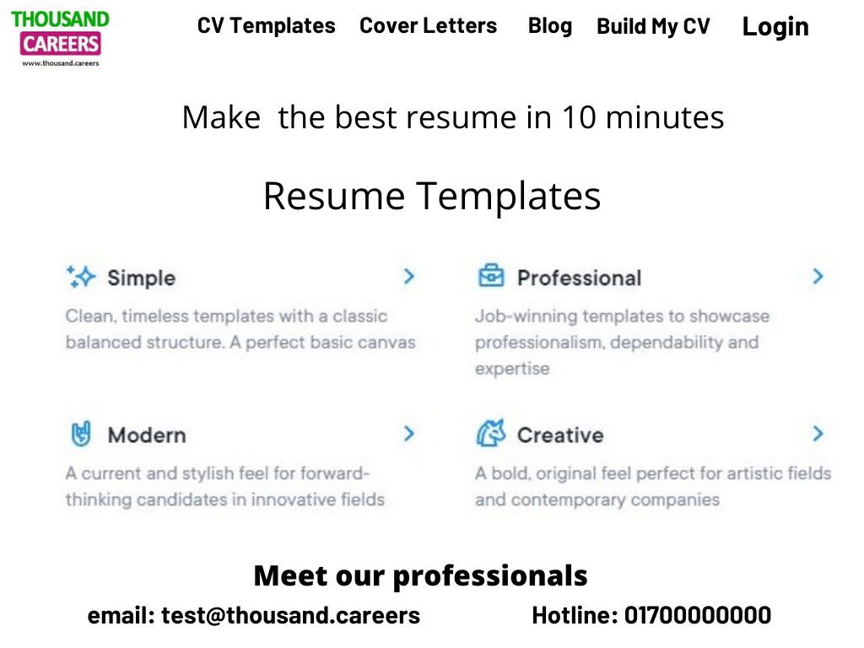
After completing the registration, user will be taken to the following page of CV making( sample)

Slide 4
Once the user click any sample, they will take to the desired CV making page( e.g.: simple, professional etc.) that will have structured in our TC site. Users can easily make their cv there and able to download them in pdf format later.
Our present CV-making format is a good example of simple templates. We can make other few templates like Professional, modern, etc. to make our site more attractive for the users ( Modern or creative type templates can be kept paid for the users as well)
I have visited different resume making sites to gather ideas and the following sites seem fantastic to me:
https://cvmkr.com/
https://novoresume.com/
https://resume.io/
https://www.coolfreecv.com/builder-creator-cv

