Slide 1

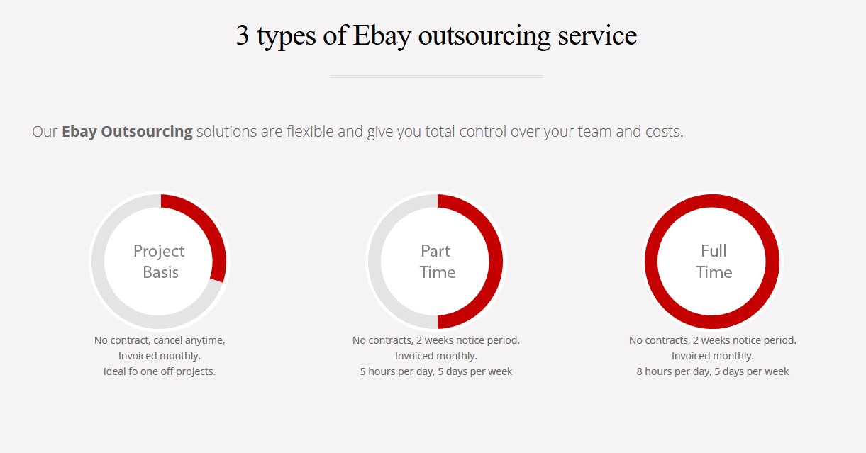
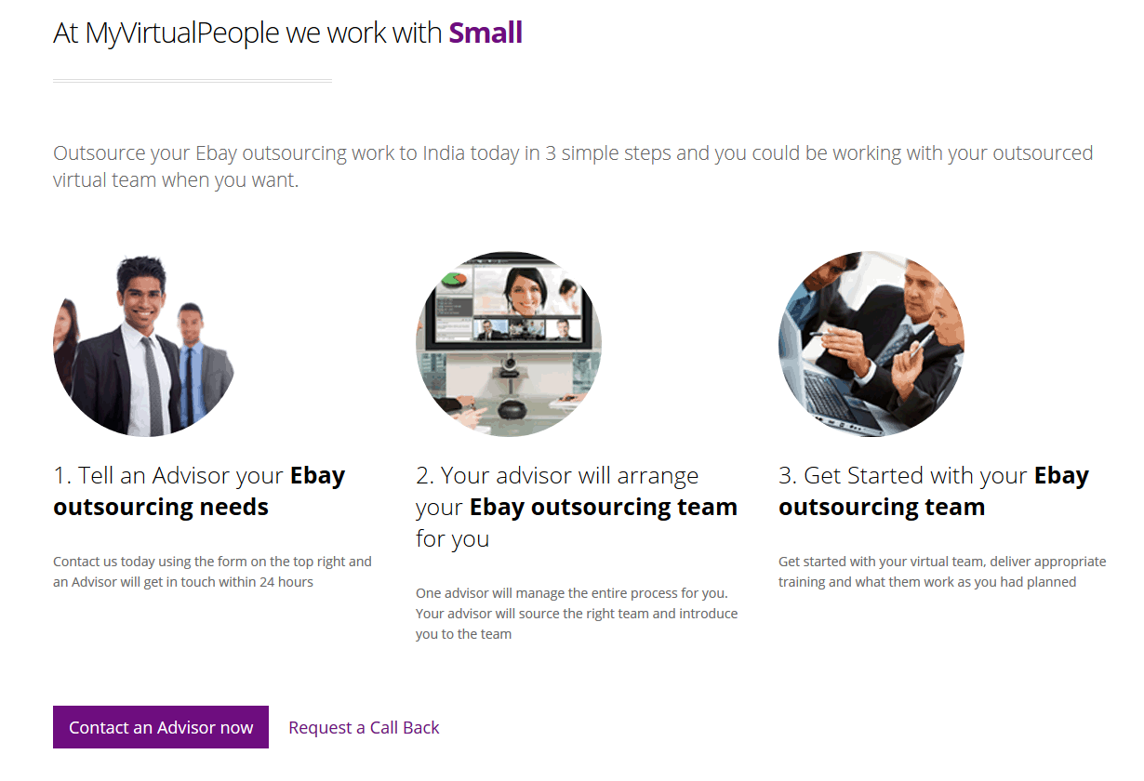

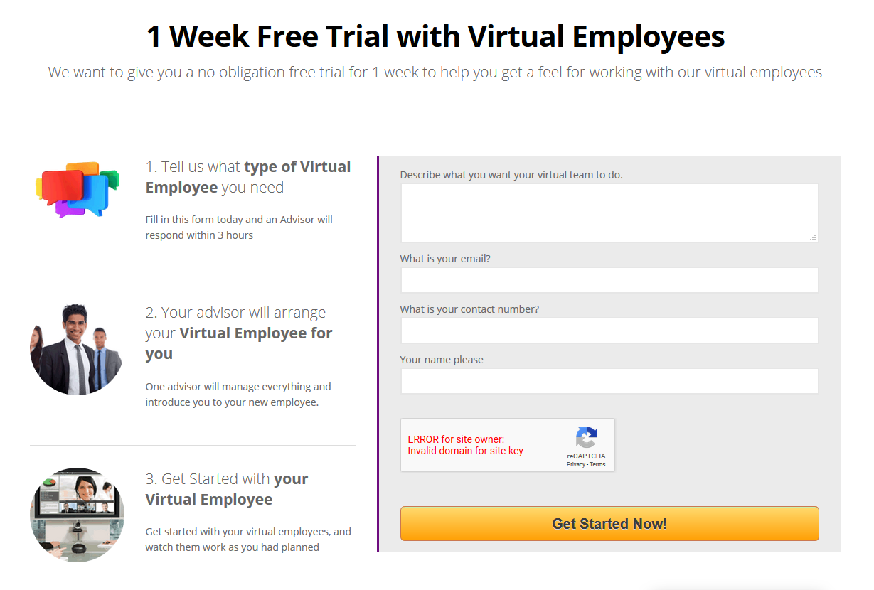
<this is full page banner with a suitable background image. After user click search the text content below will appear>
So you Need Ebay Virtual Assistants for your Online Business?
I need an Ebay Virtual Assistant for:
Search
What Are The Tasks eBay Virtual Assistant Do
eBay Product Listing
Our eBay VA will list your products quickly and efficiently to save you the time. You will also get the extra advantages of optimized title, optimized description, keywords, feature updates, etc.
h
eBay Description Writing for Your Products
For this you need the best possible title and description, and this is what we can provide. We will present your products relevant content keywords to promote your search engine visibility.

Image Editing and Cropping
To make your images eye-catching and showing your products as clear and presentable, we offer image editing software services that include cropping, resizing and retouching. High quality images have been proven to increase sales, so we make use of product photos to improve the shopping experience.

eBay Order Processing
We can process your orders to ensure a reliable and speedy service for a job that is often overlooked.

eBay Price Research
Through our thorough research, we can ensure that the prices you sell your products at will give you the edge you need.


eBay Product Uploads Using Listing Software
We have expertise in using such listing software as Inkfrog, Sellbrite, Vendio, Turbo Lister and Blackthorne, and this allows us to list on more than one platform at any one time. It also allows us to upload multiple items at once, and to manage buyer feedback, the tracking of sales and auctions.

eBay Inventory Management
This service makes sure you are constantly aware of the status of your products, and how quickly they are reaching their destinations.
Managing an entire eBay catalog can be a tiring and lengthy job – especially when your catalog includes more than 50 products. Why would you do this by yourself?
Our expert eBay Virtual Assistants are specifically trained to deal with all eBay tasks so you can spend your money and time on developing your strategies, growing your business, and watching your sales margins soar!

eBay Competitor Analysis and Market Research
We look at your market and your competition and make an analysis of them in terms of size, prices, bids and listings. This helps us to see which techniques work best so we can apply them in selling your projects.
Here are some of our Ebay Virtual Assistants
Ready to start working with you
John
John has worked with ebay clients listing products and order processing. He is an entry level candidate.
Pay Rate $4 p/hr
Hire this VA
John
John has worked with ebay clients listing products and order processing. He is an entry level candidate.
Pay Rate $4 p/hr
Hire this VA
John
John has worked with ebay clients listing products and order processing. He is an entry level candidate.
Pay Rate $4 p/hr
Hire this VA

